Slide 1
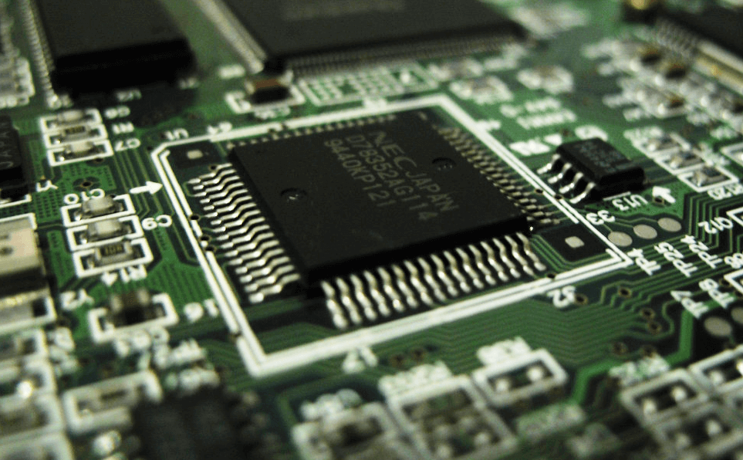
8085 Microprocessor
Dr. Manju Khurana
Assistant Professor, CSED
TIET, Patiala
manju.khurana@thapar.edu

Slide 2
Features of Microprocessor- 8085
Introduction to Microprocessor Based Systems Design
8085 is developed by INTEL.
8 bit microprocessor: can accept 8 bit data simultaneously.
Operates on single +5V D.C. supply.
Designed using NMOS technology.
6200 transistor on a single chip.
It provides on chip clock generator, hence it does not require external clock generator.
Operates on 3MHz clock frequency.
8bit multiplexed address/data bus, which reduce the number of pins.
16address lines, hence it can address 2^16 = 64 K bytes of memory
It generates 8 bit I/O addresses, hence it can access 2^8 = 256 I/O ports.
5 hardware interrupts i.e. TRAP/RST4.5, RST 7.5, RST 6.5, RST 5.5, and INTR
It provides DMA (Direct memory access).
40-pin I.C. package fabricated on a single LSI chip.
Clock cycle is 320ns.
80 basic instructions and 246 opcodes.

Slide 3
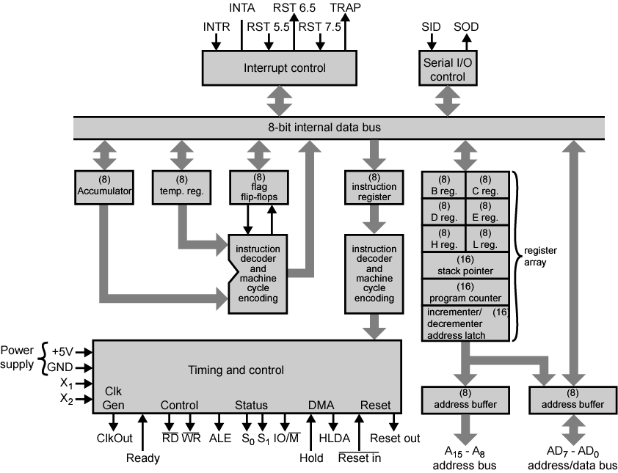
Block Diagram of Intel 8085
Introduction to Microprocessor Based Systems Design
3

Slide 4
Intel 8085 Architecture
Introduction to Microprocessor Based Systems Design
8085 architecture consists of following blocks:
1. Register Array
2. ALU & Logical Group
3. Instruction decoder and machine cycle encoder, Timing and control circuitry
4. Interrupt control Group
5. Serial I/O control Group
4

Slide 5
Intel 8085 Architecture contd.
Introduction to Microprocessor Based Systems Design
1. Registers Array :
General purpose register : (user accessible)
B, C, D, E, H, L are 8 bit register. (can be used singly)
Can also be used for 16-bit register pairs- BC, DE & HL.
Used to store the intermediate data and result
H & L can be used as a data pointer (holds memory address)
Special Purpose Register [A, Instruction Register and Flag]
(b.1) Accumulator (A) : (user accessible)
8 bit register
All the ALU operations are performed with reference to the contents of Accumulator.
Result of an operation is stored in A.
Store 8 bit data during I/O transfer
(b.2) Instruction Register: (user not accessible)
When an instruction is fetched from memory, it is loaded in IR. Then transferred to the decoder for decoding.
It is not programmable and can not be accessed through any instruction.
5

Slide 6
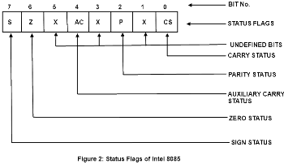
Intel 8085 Architecture contd.
Introduction to Microprocessor Based Systems Design
(b.3) Flag Register (F) : (user accessible)
8 bit Register
Indicates the status of the ALU operation.
ALU includes 5 flip flop, which are set or reset after an operation according to data conditions of the result in the accumulator.
6

Slide 7
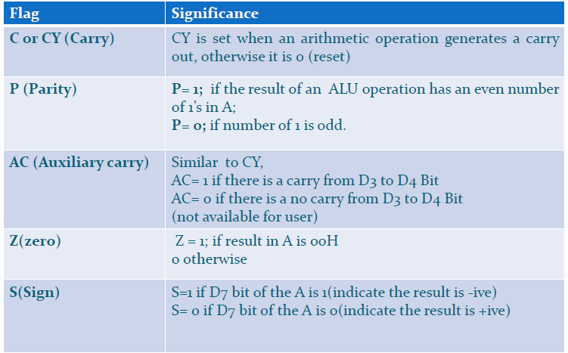
Intel 8085 Architecture contd.
Introduction to Microprocessor Based Systems Design
7

Slide 8
Intel 8085 Architecture contd.
Introduction to Microprocessor Based Systems Design
(c) Temporary Register [ W, Z, Temporary data register]
Internally used by the MP(user not accessible)
(c.1) W and Z register:
8 bit capacity
Used to hold temporary addresses during the execution of some instructions
(c.2) Temporary data register:
8 bit capacity
Used to hold temporary data during ALU operations.
8

Slide 9
Intel 8085 Architecture contd.
Introduction to Microprocessor Based Systems Design
(d) Pointer Register or special purpose [SP, PC]
(d.1) Stack Pointer (SP)
16 bit address which holds the address of the data present at the top of the stack memory
It is a reserved area of the memory in the RAM to store and retrieve the temporary information.
Also hold the content of PC when subroutines are used.
When there is a subroutine call or on an interrupt i.e. pushing the return address on a jump, and retrieving it after the operation is complete to come back to its original location.
(d.2) Program Counter (PC)
16 bit address used for the execution of program
Contain the address of the next instruction to be executed after fetching the instruction
it is automatically incremented by 1.
Not much use in programming, but as an indicator to user only.
9

Slide 10
Intel 8085 Architecture contd.
Introduction to Microprocessor Based Systems Design
In addition to register MP contains some latches and buffer
Increment and decrement address latch
16 bit register
Used to increment or decrement the content of PC and SP
Address buffer
8 bit unidirectional buffer
Used to drive high order address bus(A₈ to A₁₅)
When it is not used under such as reset, hold and halt etc this buffer is used tri-state high order address bus.
Data/Address buffer
8 bit bi-Directional buffer
Used to drive the low order address (A₀ to A₇) and data (D₀ to D₇) bus.
Under certain conditions such as reset, hold and halt etc this buffer is used tri-state low order address bus.
10

Slide 11
Intel 8085 Architecture contd.
Introduction to Microprocessor Based Systems Design
(2) ALU & Logical Group: it consists of ALU, Accumulator, Temporary register and Flag Register
ALU
Performs arithmetic and logical operations
Stores result of arithmetic and logical operations in accumulator
Accumulator
General purpose register
Stores one of the operand before any arithmetic and logical operations and result of operation is again stored back in Accumulator
Store 8 bit data during I/O transfer
Temporary Register
8 bit register
During the arithmetic and logical operations one operand is available in A and other operand is always transferred to temporary register
For Eg.: ADD B – content of B is transferred into temporary register before actual addition
Flag Register
Five flags are connected to ALU
After the ALU operation is performed the status of result will be stored in five flags.
11

Slide 12
Intel 8085 Architecture contd.
Introduction to Microprocessor Based Systems Design
(3) Instruction decoder and machine cycle encoder, Timing and control circuitry
Instruction decoder and machine cycle encoder :
Decodes the op-code stored in the Instruction Register (IR) and establishes the sequence of events to follow.
Encodes it and transfer to the timing & control unit to perform the execution of the instruction.
Timing and control circuitry
works as the brain of the CPU
For proper sequence and synchronization of all the operations of MP, this unit generates all the timing and control signals necessary for communication between microprocessor and peripherals.
12

Slide 13
Intel 8085 Architecture contd.
Introduction to Microprocessor Based Systems Design
(4) Interrupt Control group
Interrupt:- Occurrence of an external disturbance
After servicing the interrupt, 8085 resumes its normal working sequence
Transfer the control to special routines
Five interrupts: - TRAP, RST7.5, RST6.5, RST5.5, INTR
In response to INTR, it generates INTA signal
(5) Serial I/O control Group
Data transfer D₀- D₇ lines is parallel data
But under some conditions it is used serial data transfer
Serial data is entered through SID (serial input data) input (received)
Serial data is outputted on SOD (serial output data) input (send)
13

Slide 14


